Slide 1
Vietnam Memories
Patrick L. Johnson
Reflections Through
His Poetry

Slide 2
INDEX
Poem Title | Page
Hot August Night | 3
The Summer of ’66 | 4
The Letter Read | 5-6
Ode to Doug Blair | 7
The Journey | 8-9
The Memories Linger | 10-11
Vahalla Awaits | 12
Willy Peter | 13
A Hill Called Willy | 14
GI (Government Issue) OD (Olive Drab | 15-16
War, What War | 17
Broken | 18-19
Veterans Day | 20-21
Reflections on the Duster | 22
Author Information | 23
Photo Credits: All photos are publicly available on the internet and were used only for poetic inspiration

Slide 3
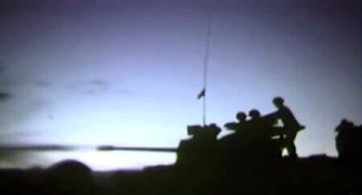
Hot August Night
It’s a hot August night in An Lao Valley
misty rain falling steady without stop
Poncho hooches fail to keep bodies dry
as tiny rivers flow through the temporary shelters
Mosquitoes swarm ignoring tons of repellent
plastered on hands and faces
Soaked soldiers conjure visions of an R&R to Bangkok
or a “million dollar wound”
Mad Minute approaches and the dreams must stop
in An Lao Valley on a hot August night

Slide 4
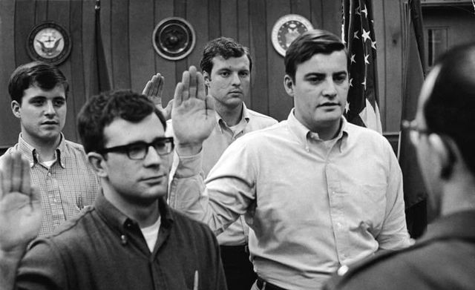
The Summer of ’66
He was home on a lunch break from his summer job
Wondering if his grades were so bad he wouldn’t be able to go back to school
He heard someone walking up the sidewalk toward the open front door
It was the mailman delivering a handful of bills along with one legal sized envelope
He dropped the bills unopened on a roll top desk that set in the dining room
The other piece of mail was from the US Government and was addressed to him.
It seems his friends and neighbors had enrolled him in a two year graduate program
Full scholarship, room and board included

Slide 5
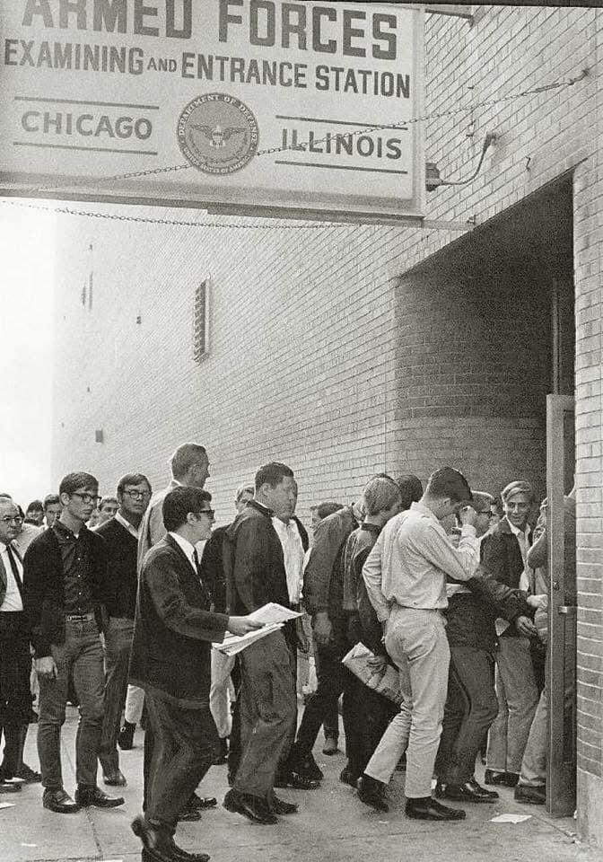
The Letter Read:
Report to the local bus station
at O six forty five
No need to bring a change of clothes
the Army will provide
The induction center was busy
it was the summer of '66
One last chance for a 4F rating
before reality hits
continued

Slide 6
The Letter Read continued
We landed on Fort Polk's tarmac
at a sultry two A M
Met by a gang of angry, yelling
green clad Army men
Shuffled off to wooden barracks
where everything was green
Even the dimly lit light bulbs
at least that's how it seemed
They gave us 50 cent hair cuts
buzzed down to our bare skulls
Boxer shorts, olive drab fatigues
and two pair of combat boots

Slide 7
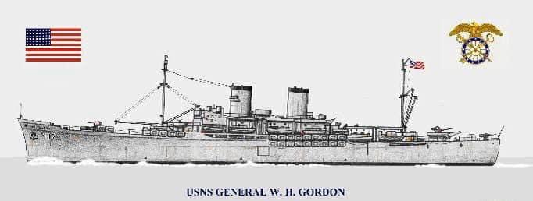
Ode to Doug Blair
A mass of gun metal grey
like we had never seen before
sitting along side the dock in silence, waiting for its cargo to load
29 days on the open sea
lounging in the Pacific sunshine
on an open deck, Doug and me
singing Sunshine Superman and
Ruby Tuesday, over and over and
over

Slide 8
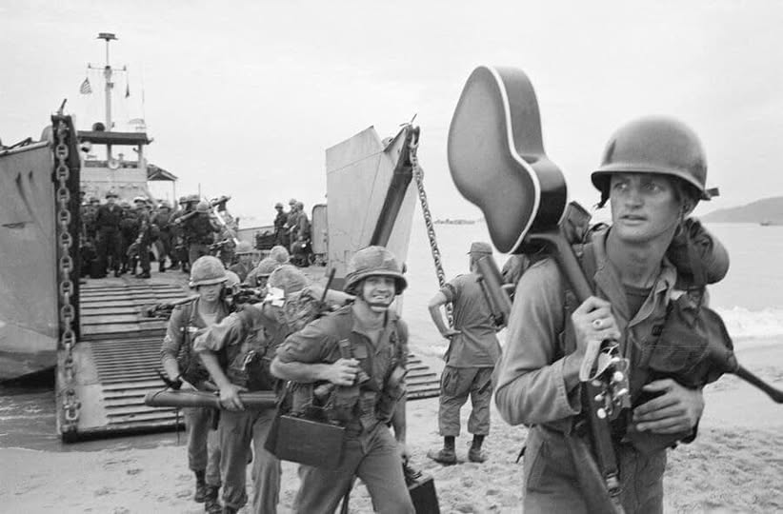
The Journey
There it was
a vastness of gun metal gray
sitting in the salty bay water waiting for its cargo
of young men clad in OD green fatigues with
barracks bags draped across tired shoulders
The journey begins as the great ship sails
under the Golden Gate into the vast Pacific
moving ever so slowly through the open sea
en route to a land of apprehension and mystery
We sat on the deck singing Beatles songs,
continued

Slide 9
The Journey Continued
watching flying fish and sea gulls as they glided
across the sky waiting for scraps from the ship’s galley
to be thrown off the stern into churning water below
And on the 29th day she dropped anchor off shore and we
slid down metal chutes, like kids on a park slide, into waiting landing craft
that bounced back and forth from the force of a choppy sea
The boats took us to the beach where the front ends opened
and spit us out onto the soft wet sand like the whale that swallowed Jonah and we loaded onto Army trucks that hauled us away
Dedicated to the “boat people

Slide 10
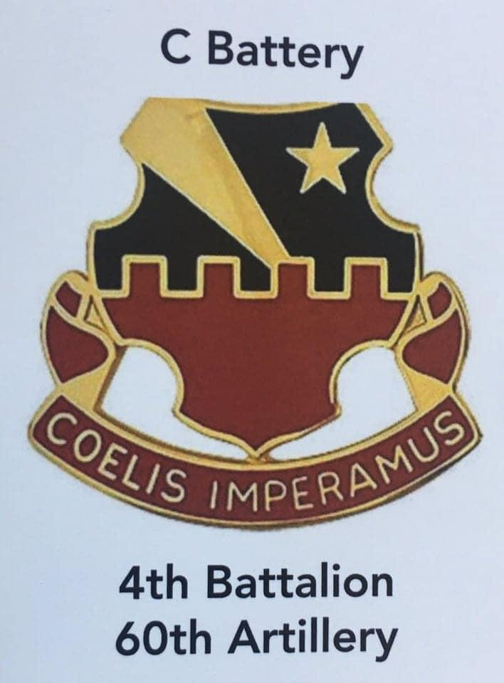
The Memories Linger
Fifty plus years and the memories linger
of young men clad in OD green
herded into a gray troop ship
wondering what lay ahead
and who among them would return
of young men clad in OD green
riding down dusty roads
enroute to unknown places
with strange sounding names
Phu Cat, Bong Song, An Lao
continued

Slide 11
The Memories Linger Continued
of young men clad in OD green
riding down dusty roads
enroute to unfamiliar places
christened by soldiers before them
Two Bits, Willy, Geronimo
of young men clad in OD green
cleaning guns, filling sand bags, arguing over who gets the beans and weenies and poundcake
of young men clad in OD green
walking to the ville where comely young women with long silky black hair sold cokes and other things
the memories linger

Slide 12
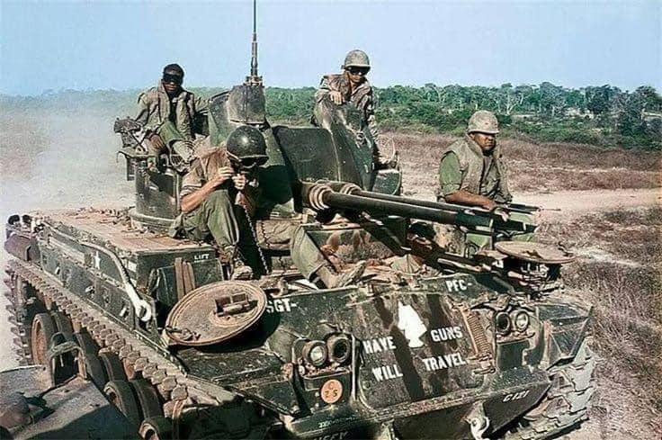
Valhalla Awaits
We were Vikings running the dirt roads of the countryside on 25 tons of fire spitting horror. We thought ourselves invincible until a 50 pound bomb planted stealthily in the red dirt below exploded with the force of Thor’s hammer and blew the langskip into a dried rice paddy where bodies were crushed and broken.
We felt ourselves indestructible when riding our thunder booming steel dragon past grass hooches and water soaked fields until the shock of an rpg with the power of Odin’s spear ripped a ragged hole in the one inch steel lamellar and tore apart mortal flesh and bone.

Slide 13
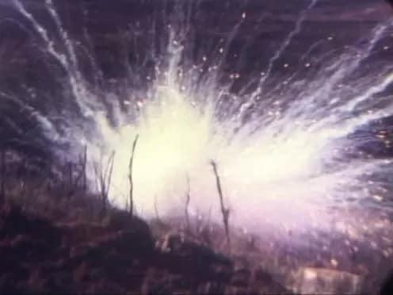
Willy Peter
The one-O-five marking round fell short landing in the middle of the perimeter
White phosphorus shrapnel flew
randomly embedding itself into five young troopers whose jungle fatigues offered no protection from the jagged willy peter soaked steel
Their screams flowed quickly through the night air into every fighting position reminding us that the VC was not the only enemy sneaking in out of the darkness

Slide 14
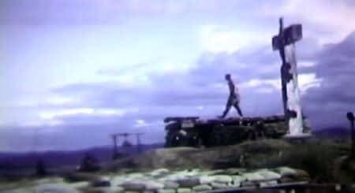
A Hill Called Willy
Jesus at the top
Buddha on bottom
Hell fire in between
Two dusters and a quad
ready to rain Armageddon
Down on any unsuspecting soul
still roaming the An Lao Valley
Everybody wonders why
we’re here
Everybody wonders if we’ll
make it home

Slide 15
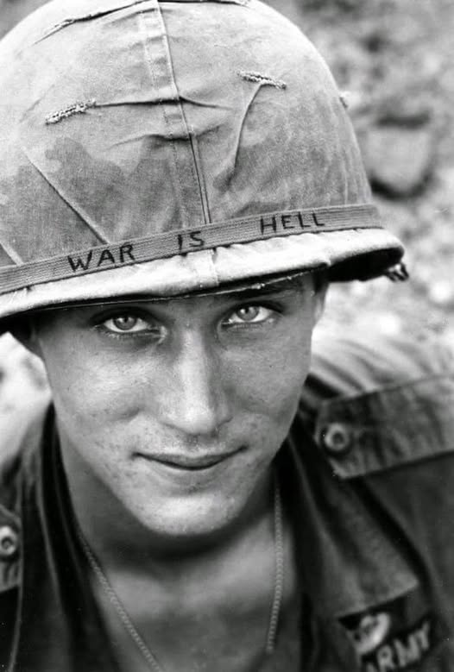
GI
(Government Issue)
OD
(Olive Drab)
I humped the paddy dikes
and walked patrol
I carried the tube
that fired the mortar rounds
I pulled the lanyard
and yelled round out
I waited for instructions
to fire for effect
I road twin forty Dusters
up valley roads
I feared the mines
that were planted in the ruts
continued

Slide 16
GI and OD continued
I filled the sandbags
and built a bunker or two
I set claymores up
just outside the wire
I drove a deuce and a half
filled with c-rations and ammo
I delivered the fuel
that kept the choppers flying
I carried a medic's bag
and patched up the wounded
I worked the ward at the
Evac hospital
I wore olive drab socks
and boxer drawers
I was an American GI
government issue to the core

Slide 17
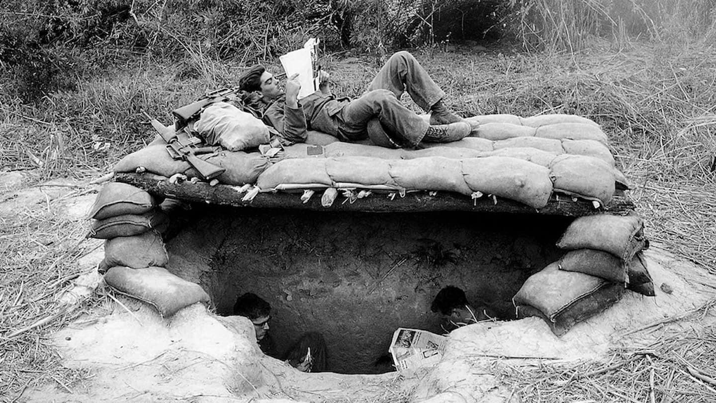
War, What War
With sand bag acoustics and young spirits renewed
We spent nights dancing the bunker boogaloo
O’Dwyer would shake with the rhythm of a mambas snake
Sweat soaked body pulsating to the Queen of rhythm and blues
We dreamed of high school hops, young girls in bobby socks
Drive in movies, back seats,and romantic rendezvous

Slide 18
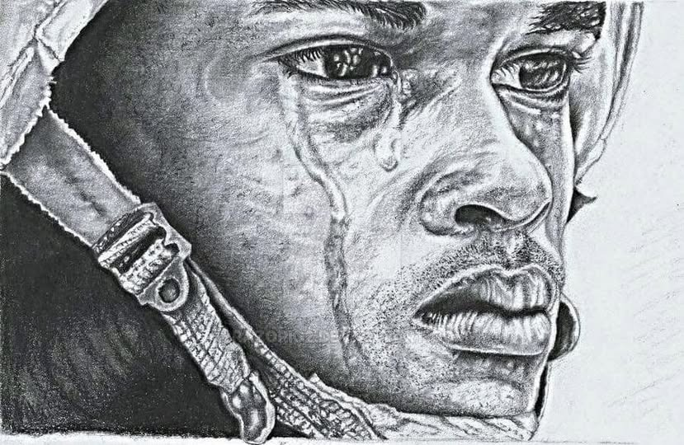
Broken
Ma, I’m coming home, your little boy is coming home
Ma, can you cook a pot of beans and a pan of cornbread,
You know, baked in the iron frying pan with lots of bacon grease
Ma, I’m coming home, tainted and crazy and often times blue
Ma, will you cook blackberry cobbler from fresh berries
You know, with the sugary thick dumplings that float on top
continued

Slide 19
Broken continued
Ma, I’m coming home, away from the nightmares that haunt me
Ma, will you cook up a mess of polk salad and a big fat chicken
You know, fried with real thick crust and a dab of grease in the polk
Ma, I’m coming home, don’t worry if I get weepy and sob sometimes
Ma, can you whip up some biscuits and sausage gravy
You know, with some black strap molasses to top them off
Ma, I’m coming home, broken and torn apart on the inside
Ma, can you hold me like you used to and rub my head
You know, tell me you love me and that everything will be alright

Slide 20
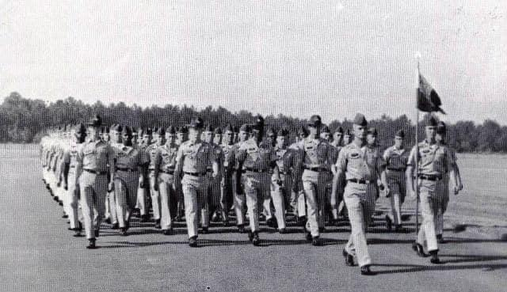
Veterans Day
We were children, just babies to our mothers,
chosen to wear a uniform and fight our country’s wars
We came from cities and towns, farms and ranches
and bonded together like brothers and cousins
Some carried weapons, some manned the bridge,
some fueled the jets, some guarded the homeland
And today we remember
continued

Slide 21
Veterans Day continued
Not the wars, not the sweltering heat, not the relentless rains or the storms at sea
Today we remember those we served beside
The big kid who humped the M60, the wiry kid who chipped the gray paint from the ship’s bow
The cook who worked the galley, the best friend that drove the tank
The kid from East Harlem who found a home in the Army
And we remember the ones who are gone, the ones who lost their lives while wearing the uniform
Today we remember our youth.

Slide 22
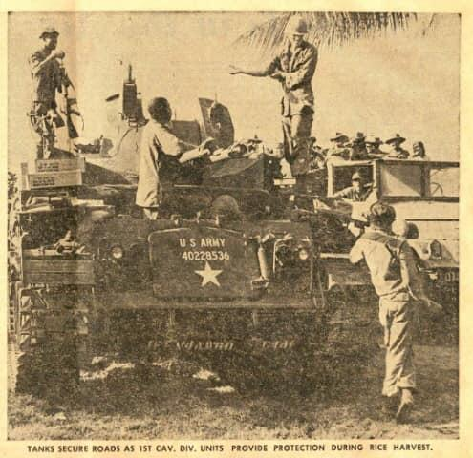
Patrick L Johnson reflects on his Duster
M42A1 Automatic Weapon Self Propelled, more commonly known as a "Duster" was in my opinion the most powerfully armed squad sized unit in the Vietnam War. Twin 40mm guns capable of firing 240 rounds per minute, side or rear mounted M60 machine gun, each crew member issued an M16, usually a case or more of grenades, a claymore or two, some had 12 gauge shotguns. C/4/60, spring and summer of 1967 subsequent to removing all inhabitants and participating in search and destroy operation of An Lao Valley.

Slide 23
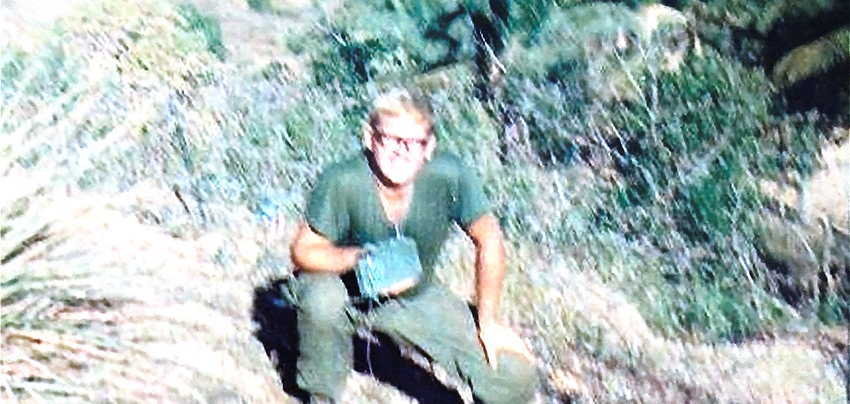
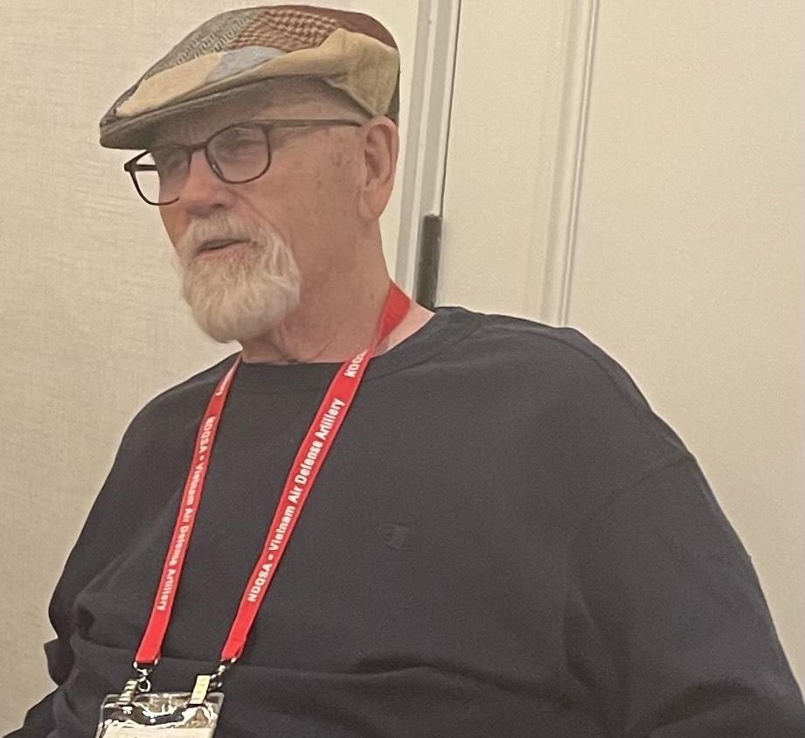
Patrick L. Johnson - Author
Patrick was drafted in June 1966. After basic at Fort Polk and AIT at Fort Sill, he was assigned to C Battery, 4th Battalion, 60th Artillery at McGregor Range and in February 1967 went to Vietnam with the Battalion on the USNS Gordon.
After arrival in country, C Battery was attached to the 1st Cavalry Division and set up its HQ at LZ Two Bits. Patrick was a loader on a Duster until November when he was moved to a Quad where he spent his last 90 days.
After separation from the Army in July 1968, he returned to Oklahoma, got married to hsi wife of 56 years, raised two sons and became a firefighter retiring after 25 years service.

